Slide 1
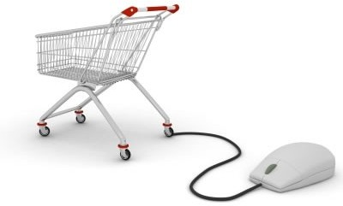
PAYMENT SYSTEMS FOR ELECTRONIC COMMERCE
1
Presented By:
-Soumojyoti Ganguly

Slide 2

INDEX
○ Introduction to E-payment
○ Modes of E-payment
 Payment cards-
○
○
○
Intro to credit card, debit card & charge car Acceptance and processing
Advantages and Disadvantages
d
 Electronic cash-
○
○
○
Introduction and concern of cash Advantages
Disadvantages
 Click Free
Click Share
Electronic Wallet
Smart Card
2

Slide 3

ELECTRONIC PAYMENT SYSTEMS
○ E-payment or Electronic payment is any digital financial payment transaction involving currency transfer between two or more parties
○ Implementation of electronic payment systems is in its infancy and still evolving.
○ Electronic payments are far cheaper than the traditional method of mailing out paper invoices and then processing payments received.
3

Slide 4
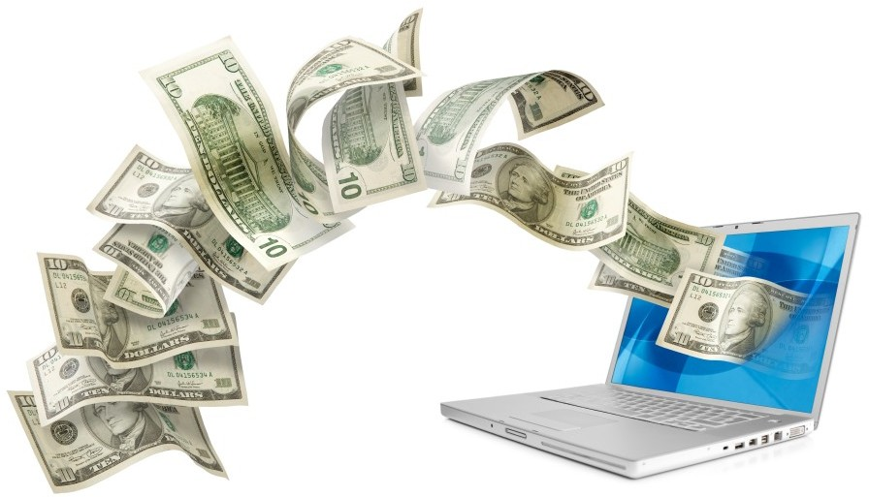
Modes of E-Payment
○ Payment Cards
○ Electronic Cash
○ Check free
○ Check share
○ Internet Cash
○ Wallet
○ Smart Card
4

Slide 5
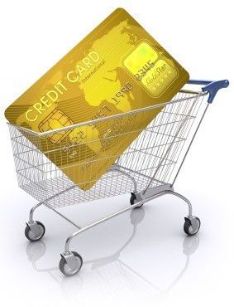
PAYMENT CARDS
○ Payment cards are all types of plastic cards that consumers use to make purchases:
Credit cards
○ such as a Visa or a MasterCard, has a preset spending limit based on the user’s credit limit.
Debit cards
○ removes the amount of the charge from the cardholder’s account and transfers it to the seller’s bank.
Charge cards
○ such as one from American Express, carries no preset spending limit.
5

Slide 6
PAYMENT ACCEPTANCE AND PROCESSING
○ Open and closed loop systems will accept and process payment cards.
○ A merchant bank or acquiring bank is a bank that does business with merchants who want to accept payment cards.
○ Software packaged with your electronic commerce software can handle payment card processing automatically.

Slide 7
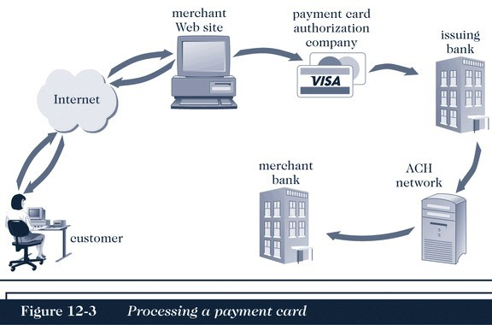
PAYMENT ACCEPTANCE AND PROCESSING

Slide 8

ADVANTAGES AND DISADVANTAGES
OF PAYMENT CARDS
○ Advantages:
Payment cards provide fraud protection.
They have worldwide acceptance.
They are good for online transactions.
○ Disadvantages:
Payment card service companies charge merchants per-transaction fees and monthly processing fees.

Slide 9

ELECTRONIC CASH
○ Electronic cash is a general term that describes the attempts of several companies to create a value storage and exchange system that operates online in much the same way that government-issued currency operates in the physical world.
○ Concerns about electronic payment methods include:
Privacy
Security
Independence
Portability
Convenience

Slide 10
HOLDING ELECTRONIC CASH: ONLINE AND OFFLINE CASH
○ Two approaches to holding cash: online storage and offline storage.
○ Online cash storage means that an online bank is involved in all transfers of electronic cash.
○ Offline cash storage is the virtual equivalent of money you keep in your wallet. However, it must prevent double or fraudulent spending.

Slide 11
ADVANTAGES OF ELECTRONIC CASH
○ Electronic cash transactions are more efficient and less costly than other methods.
○ The distance that an electronic transaction must travel does not affect cost.
○ The fixed cost of hardware to handle electronic cash is nearly zero.
○ Electronic cash does not require that one party have any special authorization.

Slide 12
DISADVANTAGES OF ELECTRONIC CASH
○ Electronic cash provides no audit trail.
○ Because true electronic cash is not traceable, money laundering is a problem.
○ Electronic cash is susceptible to forgery.
○ So far, electronic cash is a commercial flop.

Slide 13
CHECK FREE
○ CheckFree provides online payment processing services to both large corporations and individual Internet users.
○ CheckFree permits users to pay all their bills with online electronic checks.
○ CheckFree provides part of the technology that the Web portal Yahoo! uses to provide its Yahoo! Bill Pay service.

Slide 14
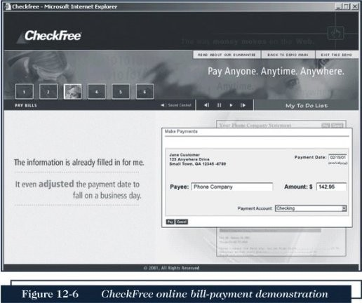
CHECK FREE

Slide 15
CLICK SHARE
○ Clickshare is an electronic cash system aimed at magazine and newspaper publishers.
○ Users with an ISP that supports Clickshare are automatically registered with Clickshare.
○ Clickshare tracks users with the standard HTTP Web protocol.

Slide 16
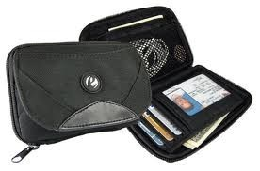
ELECTRONIC WALLETS
○ An electronic wallet serves a function similar to a physical wallet:
holds credit cards, electronic cash, owner identification, and owner contact information
provides owner contact information at an electronic commerce site’s checkout counter
○ Some electronic wallets contain an address book.

Slide 17
ELECTRONIC WALLETS
○ Electronic wallets make shopping more efficient.
○ Electronic wallets fall into two categories based on where they are stored:
•
•
Server-side electronic wallet Client-side electronic wallet
○ Electronic wallets store shipping and billing information, including a consumer’s first and last names, street address, city, state, country, and zip or postal code.
○ E.g. Microsoft .NET passport ,yahoo! Wallet

Slide 18

THE W3C PROPOSED STANDARD
○ The W3C Electronic Commerce Interest
Group (ECIG) developed a set of standards called the the Common Markup for Micropayment Per- Fee-Links.
○ This standard identifies existing system micropayment types of online connections, stored-value systems, and combined online- offline systems.

Slide 19
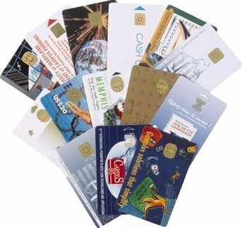
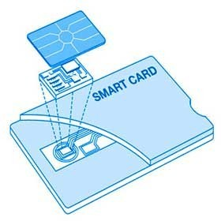
SMART CARD
○ A smart card is a plastic card with an embedded microchip containing information about you.
○ A smart card can store about 100 times the amount of information that a magnetic strip plastic card can store.
○ A smart card contains private user information, such as financial facts, private encryption keys, account information, credit card numbers, health insurance information, etc.
○ E.g. Mondex smart card , Octopus smart card
19

Slide 20
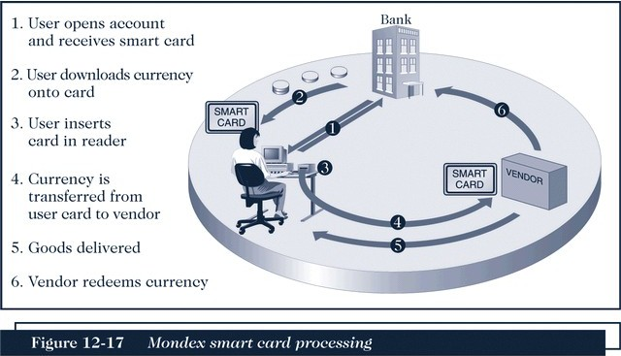
MONDEX SMART CARD
20

Slide 21
THANK YOU!!
21
The End

